Slide 1
Banking Transactions & Customer Behavior Dataset
Name – Harshita Sahu
Date – 25/11/25

Slide 2
Business Overview
Berka Dataset shows the real-world banking dataset how the banks really works , how customer accounts are managed how the financial transactions flow between the banking systems . This datasets tells us spending patterns ,customer behavior including spending patterns, account management , loan usage ,risk categorizes
This datasets allows us to understand :
Which type of transactions occurs more frequently .
How the money is flowing between the accounts
Categorizing Customer as Low Risk customer to High Risk Customer
How the regional and demographic differences affect banking activity
How account ownership structured (ownership v/s authorized user)

Slide 3
Table Overview
Tables Brief Explanation:
Account Table – Account Details.
Card – Clients Card & Card Type Details.
Client – Client details.
Disp (Disposition) – Who operate the account.
District – anonymized/coded features about districts/customers.
Loan – Clients and their loan information
Order - Money Transfer
Trans – All transactions in the account

Slide 4
Table Summaries
Tables | Details | Rows/Columns
Account | account_id – smallint District_id – tinyint Frequency – nvarchar(50) Date – date | 4 Columns ,4500 rows
Card | Card_id – smallint Disp_id – smallint Type – nvarchar(50) Issued – nvarchar(50) | 4 Columns , 892 Rows
Client | Client_id – smallint Birth_number – int District_id - Tinyint | 3 Columns , 5,369 Rows
Disp | Disp_id – smallint Client_id – smallint Account_id – smallint Type – nvarchar(50) | 4 Columns , 5,369 Rows

Slide 5
Table Summaries
Tables | Details | Rows/Columns
Districts | A1 –Tinyint ,A2 – nvarchar(50),A3 – nvarchar(50),A4 – int , A5 – tinyint ,A6 - tinyint, A7 – tinyint , A8 – tinyint, A9 – tinyint,A10 – float,A11 – smallint,A12 – nvarchar(50),A13 – float,A14 – tinyint, A15 – nvarchar(50),A16-int | 16 Columns ,77 rows
Loan | loan_id – smallint account_id – smallint Date – Date,Amount – Int,Duration – Tinyint , payments – float,status – nvarchar(50) | 7 Columns , 682 Rows
Order | Order_id –int,Account_id – smallint ,bank_to – nvarchar(50),account_to – int, amount- float,k_symbols – nvarchar(50) | 6 Columns , 6,471Rows
Trans | trans_id – int, account_id – smallint,date - date,type- nvarchar(50),operation – nvarchar(50),amount – float , Balance – float,k_symbol – nvarchar(50),bank – nvarchar(50),account - int | 10 Columns , 10,56320 Rows

Slide 6
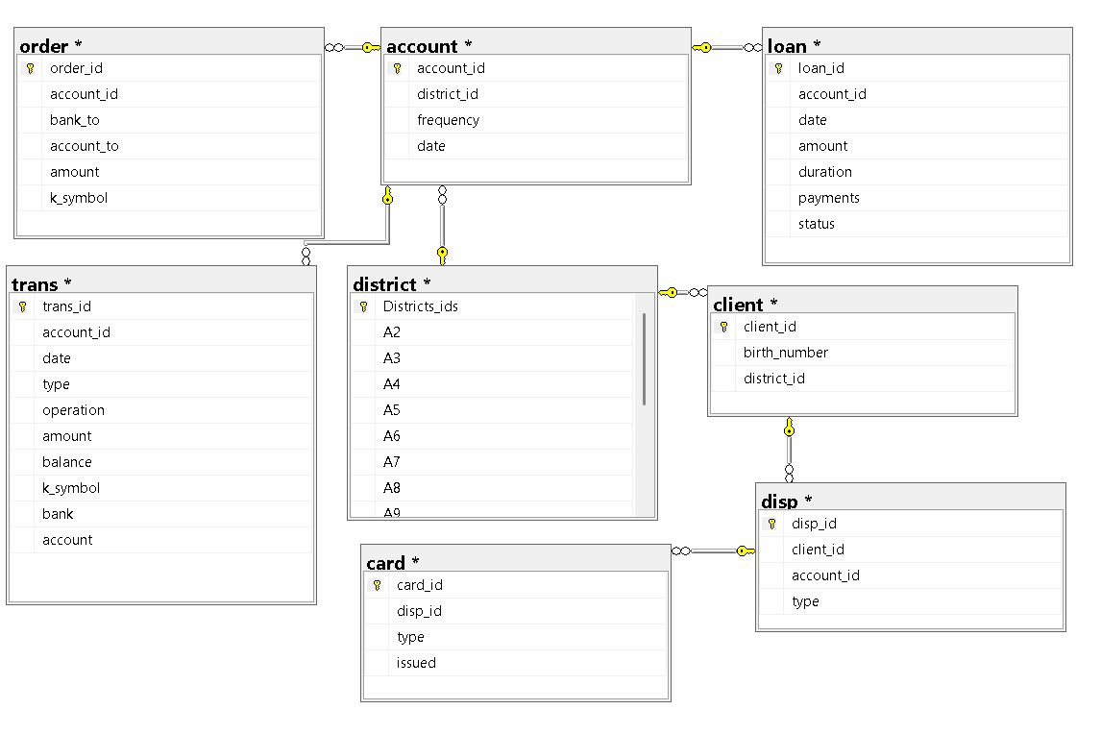
ERD DIAGRAM

Slide 7
ERD DIAGRAM Explanation
This is the Galaxy schema as there is more than one fact table and other are dimensions of the fact's tables
Fact Tables are:
Order – facts about orders
Trans – Facts about Transactions
Loan – Facts about loans
Dimensions Tables are – Account , Card , Client , Disp , District.
Fact vs Dimension Confusion
Fact table → stores measurable data (Trans, Order, Loan)
Dimension table → stores descriptive attributes (Account , Card , Client , Disp , District.)
Most tables in ERD connecting to Account are dimensions. The Account table gives context to multiple fact tables.

Slide 8
Table Relationship Diagram
Loan
Order
Trans
Fact Table
Fact Table
Fact Table
Account
Dimension Tables
District
Client
Disp
Card

Slide 9
Data Cleaning & Pre-Processing Steps
Account Table
The Column Frequency in Account Table is In Czech Language
Frequency Column values are :
‘POPLATEK MESICNE’ 'Monthly Fee’
‘POPLATEK TYDNE’ 'Weekly Fee'
‘POPLATEK PO OBRATU’ 'Fee Per Transactions’
Card Table
The Column Issued is In string format like YYMMDD 00:00:00
So changed that and only taken the date part
Converted it to YYYY-MM-DD and then in Date type

Slide 10
Data Cleaning & Pre-Processing Steps
Client Table
In Client Table the birth number is in coded form which has both gender and dob
For Females +50 is in Month and if month <=12 then that is male
Like for female it is 706213 where 70 is the year , 62 is month which is >12 so the original month will be 62-50 then 02 and the gender will be female and other are male
So , if month >12 then gender Female other are Male
For Month Part if Month>12 then minus it by 50 to get month part and then do concatenation to get dob.
Disp Table
No such changes is needed

Slide 11
Data Cleaning & Pre-Processing Steps
District Table
District Table all Columns are in the coded Format it ranges from A1-A16 with different information and with different datatypes
So, Changed the Column names Accordingly :
A1 ------------------> District_Ids
A2 ------------------> District_Name
A3 ------------------> Region
A4 ------------------> Population
A5 ------------------> Villages
A6 ------------------> Small_Town
A7 ------------------> Medium_Town
A8 ------------------> Large_Town

Slide 12
Data Cleaning & Pre-Processing Steps
A9 ------------------> No_Of_Cities
A10 ------------------> Ratio_Of_Urban_Populations
A11 ------------------> Avg_Salary
A12 ------------------> Unemployment_Rate_1995
A13 ------------------> Unemployment_Rate_1996
A14 ------------------> No_of_Enterprenuers_per_1000
A15 ------------------> No_of_Crimes_Commited_1995
A16 ------------------> No_of_Crimes_Commited_1996
Loan Table
There is no need to make changes

Slide 13
Data Cleaning & Pre-Processing Steps
Order Table
In Order Table there is a column called as k_symbol which means describes the intended purpose of a payment order.
The values in this column is in Czech language which need to get converted
‘UVER‘ ---------> ‘Loan’
‘SIPO‘ ---------> ‘SIPO_Payments’
‘LEASING‘ ---------> ‘Leasing’
‘POJISTNE‘ ---------> ‘Insurance’
Nulls ---------> ‘None’
Trans Table
In trans table there are columns type,operation,k_symbols which is not in the correct language so changed that.

Slide 14
Business Questions / Analysis
KPI’s
Total No. Of Accounts
Total No. Of Clients
Total No. Of Loan Granted
No. Of Transaction Type
Max Transaction Flow
Most Used Operation
Top K_symbol
Top 1 District Having Most Transaction
Avg Transaction Amount
Unemployment Rate

Slide 15
Business Questions / Analysis
Descriptive Analysis
Transaction Flow between Accounts & for what operation.
Most Transaction held from which district.
Which Month more Transactions more held.
Which type of Transactions more held.
Which Bank more order are held
Which Type of customer is more (Owner/Deponent).
Diagnostic Analysis
Why did loan is given to a district most.
Which Type of customer more going to take long-term loan.
What are factors going to take a loan.
What is the difference between which type of loan.

Slide 16
Business Questions / Analysis
Account & Frequency Analysis
How many accounts exist under each frequency type?
Which month shows the highest number of transactions, and what is the associated account frequency?
Card Analysis
What types of cards exist in the dataset?
Which card type is used the most?
Which card type is used the least?
Client Demographics & Segmentation
Is the customer base dominated by males or females?
What are the age groups of male and female clients, and which age group performs the most transactions?
How does the birth district compare with the district where clients hold their accounts?
Which district has the highest number of clients by birth district?

Slide 17
Business Questions / Analysis
Account Classification (DISP Table)
How can we classify accounts based on disposition type (e.g., owner, joint, authorized user)?
District-Level Insights
How is the population distributed across districts?
What is the average level of urbanization by district?
How do urban and rural districts differ in terms of urbanization percentage?
How does the average salary compare between urbanized and rural districts?
Which district has the highest average salary, and which has the lowest?
Which district has the highest unemployment rate?
Which districts have the most entrepreneurs, and what does this indicate about repayment capacity?
Which district has the highest number of criminal cases?
How is the population divided among the different types of municipalities?

Slide 18
Business Questions / Analysis
Loan Analysis
Which loan type or duration is most in demand?
How can loan amounts be segmented into high-value vs low-value loans?
How does the loan amount compare with payments, and can we predict loan repayment behavior?
How many customers fall under each loan status (A, B, C, D), and what are the characteristics of high-risk (status D) customers?
Orders Table Analysis
What is the total value of all orders?
Which bank_to receives the highest payment volume?
Which bank_to is associated with which order type?
Which order type (based on k_symbol) is the most common?
Transaction Flow Analysis
What type of transaction is happening — debit or credit?
How much money is being moved overall, and through which transaction types or operations?

Slide 19
Dashboard Layouts

Slide 20

Banking Customer Analytics Dashboard Overview
Customer Analysis
Total Customer
Total Accounts
Avg Transaction Flow
Most Transaction Operations
Slicer
1)Weekend/Weekdays
2)Yearly
3) Quarterly
[Histogram]
Type of frequency by accounted count
[Pie_Chart]
[ Distribution of cust based on card type ]
[Bar Chart]
Type Of Customer
[Doughnut Chart]
Distribution of customer based on Customer Demographic
[Bar Chart]
Age Distribution Based on services
[Pie Chart]
Distribution of customer based on Age

Slide 21
Banking Transaction Analytics Dashboard Overview
Transaction Analysis
Total No. Of Transactions
Most Type of Transaction
Most Type Of Operations
Max Transaction Amount
Slicer
1)Weekend/Weekdays
2)Yearly
3) Quarterly
[Pie Chart]
Transaction Distribution By Region
[Bar Chart]
Transactions Based On Municipalities
[Doughnut Chart]
Payment Type Distribution
[Pie Chart]
Gender Distribution
[Line Chart]
District-wise Crimes Committed vs. Transactions
[Histogram]
Operation Distribution By Transaction Frequency

Slide 22
Loan Portfolio Analytics Dashboard Overview
Loan Analysis
Total No. Of Loans
granted
Top Type of Loan
Top Type of Loan
Total Account
Avg No. Of Account Taken Loan
Slicer
1)Weekend/Weekdays
2)Yearly
3) Quarterly
[Bar Chart]
Age Distribution V/S Loan Type
[Line Chart]
Crimes Committed V/S
Loan
[Bar Chart]
Top 10 District Loan Granted
[Doughnut Chart]
Gender Distribution V/S Loan_Type
[Bar Chart]
Salary Range V/S Loan Type
[Line Chart]
Urbar Population V/S Rular V/S
Loan

Slide 23
360 Tables
Transactions_360
Transactions_360 provides a complete 360° view of all transactions.
It also integrates information from the Orders table.
The Orders table contains the instructions given by clients for performing a transaction.
Using Transactions_360, we can analyze:
Whether the customer’s instructions were properly executed
Whether the account had sufficient or insufficient balance
Whether the actual transaction matches the order details
Transactions_360 is created using information from:
Orders Table
Transactions Table
Account Table

Slide 24
360 Tables
Customer_360
Customer_360 provides a complete 360° view of each customer.
It includes detailed client demographic information, along with insights into their financial and transactional behavior.
Using the Customer_360 table, we can understand:
The type of term loan the customer has taken
Which transaction types the customer performs most frequently
The primary reasons behind those transactions
The Customer_360 table is created using information from:
Client Table
District Table
Account Table
Trans Table
Disp Table
Card Table

Slide 25
Analysis

Slide 26
Dataset Overview & Analysis
This is the Berka Dataset which gives a real-world banking datasets tells how the banks operates across 77 districts and how the transactions flows from 1993 to 1998
This datasets helps in understanding customer behaviour
This datasets consists of :
Transactions counts - 10,56,320
Customers counts – 5369
Districts – 77
Accounts – 4500
Loan taken – 682
… many more
Here our task is to analyse how the transactions flows and on the basis of what characters to grant loan

Slide 27
Key Performance Metrics
Transactions Analysis
Metrics | Values
Total Transactions | 1.1 M
Total Accounts | 4500
Max Account Balance | 2,09,637
Most Transactions Type | Expense
Most Operation Type | Withdrawals
Peak Transactions Day | Saturday
Peak Transactions Month | January

Slide 28
Key Performance Metrics
Loan Analysis
Metrics | Values
Total Loans | 682
Total Accounts | 4500
Loan Adoption Rate (%) | 15.16%
Peak Loan Year | 1997
Top Loan Type | Short - Term Loans
Top Loan Repayment Status | C
Peak Loan Month | December

Slide 29
Key Performance Metrics
Customer Analysis
Metrics | Values
Total Clients | 5369
Total Districts | 77
Total Regions | 8
Top Customer District | Hl.m. Praha
Top Customer Region | south Moravia
Top Customer Gender | Male
Top Customer Age_Grps | Adult

Slide 30
Transaction_Analysis

Slide 31
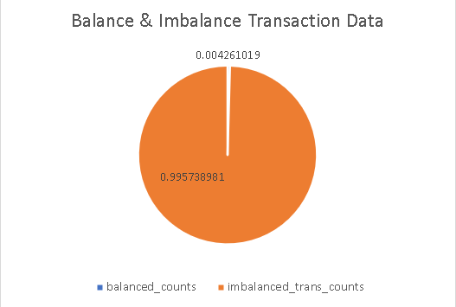
Transaction Amount vs Balance Analysis
Out of the 10,56,320 total transactions, only 0.43% of transactions have the transaction amount equal to the balance (balance after transaction).
This equality indicates that the previous account balance was zero.
The remaining 99.57% of transactions show a mismatch between amount and balance, which represents normal banking activities such as:
Withdrawals
Deposits
Fees
Payment operations
Adjustments
To understand customer behavior and banking operations, it is important to analyze how these 99%+ transactions are actually flowing.

Slide 32
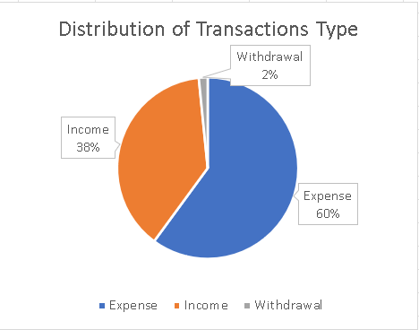
Transaction Type Distribution & Flow Analysis
These 96% of Transactions are flowing where Transactions related to expense contributes about 60% of transactions and 38% of transactions are of income at last 2% are withdrawal .
That most of the Transactions are expense related transactions
Most of the Transactions are dealing with Expenses and least with withdrawal

Slide 33
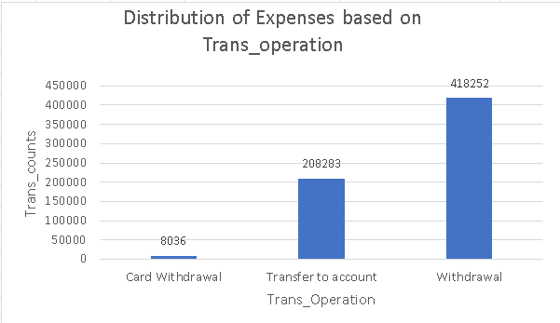
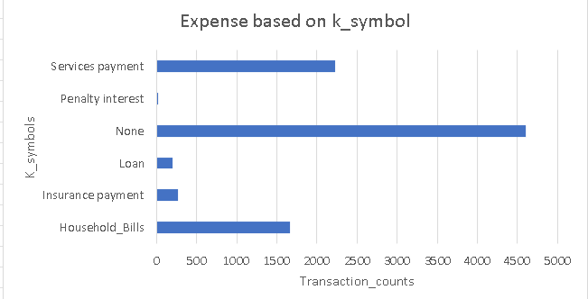
Expense Transactions: Operations & Key Drivers
There are 60% of transactions are of type Expense
These expense broadly distributed among three operations in which withdrawal contributed the most transactions about 4 lakhs and the least one is by card withdrawals on 8 thousand only.
The reasons behind the expenses can be explained by k_symbols which depicts most of are none means information has not been provided and the service payments ,household , insurance payments contributes the most then the loan and payment interest

Slide 34
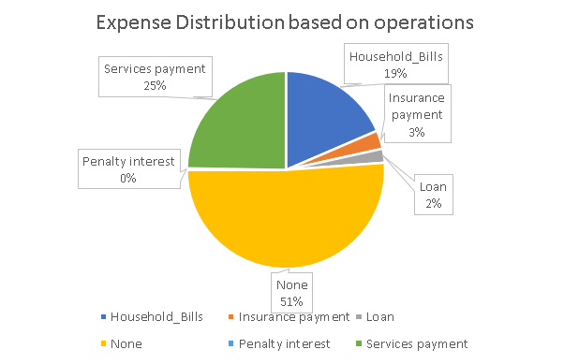
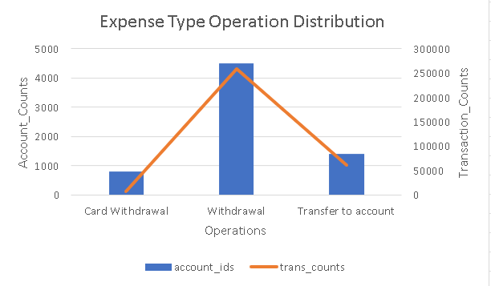
Expense Transactions Without Recorded Reasons
There are 51% of transaction under expense type which does not having a reason as their k_symbol are none
These reason can be explained by other columns like operations
This combo chart is depicting that most of the operation related to cash withdrawal haven’t recorded in k_symbols and about 4500 accounts it consists of .
Then the operation related to transfer to account haven’t recorded in k_symbols then last card withdrawals .
So , we can conclude that cash withdrawal transactions not having the reasons in transactions table then the transfer to account and at last card withdrawals.

Slide 35
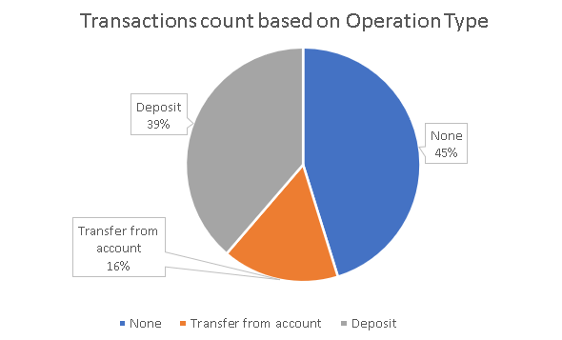
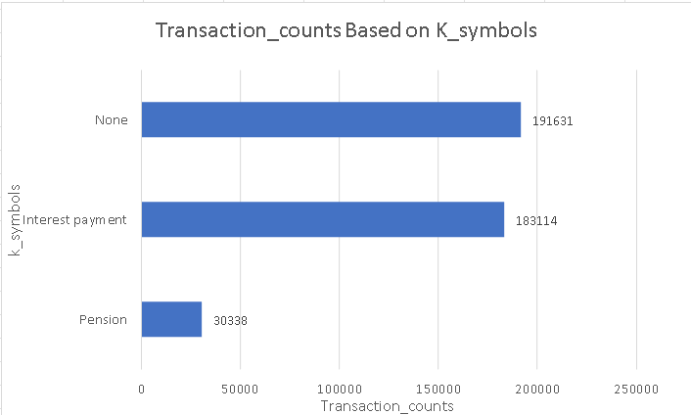
Income Transaction: Operations & Underlying Reasons
Transactions of Income Type contributed the most about 38% of it .
These Income Type transactions distributed based on operation into Transfer from account , deposits and the most percentage as none about 45%.
In order to fully understand this none in operation column we need to observe k_symbols as a reason behind the income transactions.
The k_symbols is showing as Interest_Payments which means the bank in operation for the transactions in which interest given by bank on the money kept by there customers
Since interest credits are system-generated, the dataset often leaves the operation field blank.
There are about 47% of transactions are like that where k_symbol is none which means those are cash type transactions

Slide 36
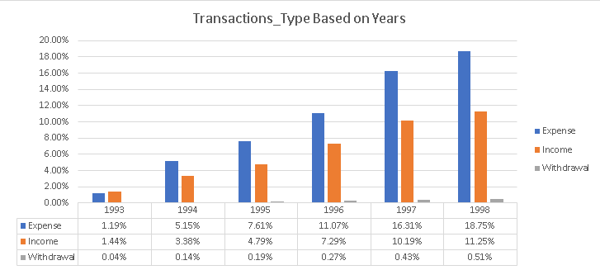
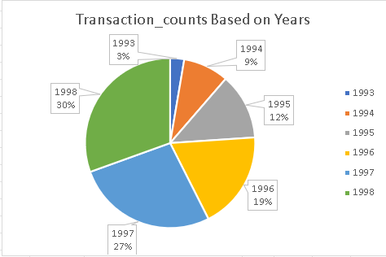
Year-Wise Transaction Trends (1993–1998)
The Berka Dataset is spanning across 6 years in which year 1998 has contributed the most and least one in year 1993 which is about only 3% .
The transaction based on various type has been gradually increasing across years in Expense there is sudden increase from year 1993 to 1994 from 1.19% to 5.15%.
Withdrawal is kind of low across all years the minimum withdrawal percentage about 0.04% and maximum is 0.51% .
Transaction of Income type is performed well in year 1997 and in 1998 but comparatively less by expense
Conclusion – the Transactions related to Expense are most across all years and they are gradually increasing from the before year .

Slide 37
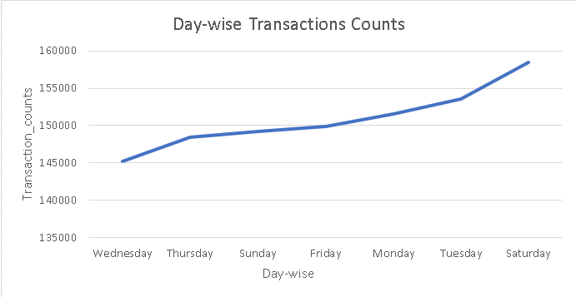
Daywise Transaction Analysis
The Berka Dataset contains a total of 1 million+ transactions.
This analysis shows how average transactions are distributed across the days of the week.
Highest transactions: Saturday — 158,499
Lowest transactions: Wednesday — 145,158
This helps in understanding customer activity patterns and peak banking days.

Slide 38
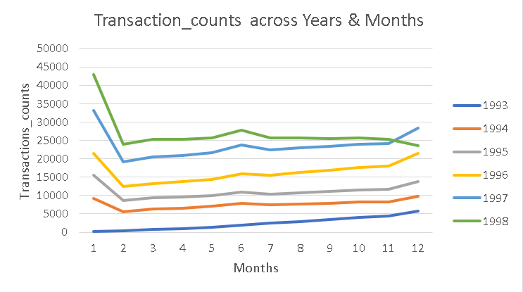
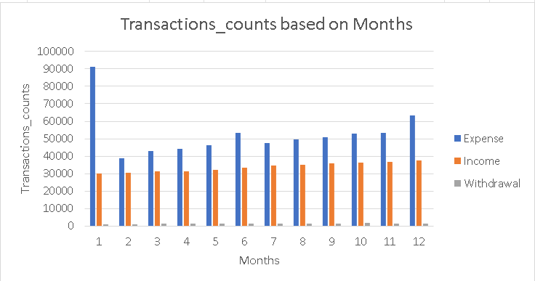
Monthly & Yearly Transaction Patterns
Transactions Based on Months & Year
The Transactions count in Month of January is most and in February there is suddenly decrease in transaction . Then it gets stabilize and then in June there is a slight increase .
Then it again stabilize
Berka Dataset is spanning across 6 years . Among 6 years in year 1998 there is a sudden fall in the transactions counts in month of November which has happened due to decrease in withdrawals transactions.

Slide 39
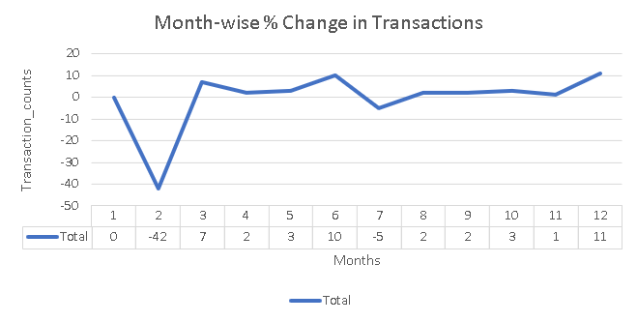
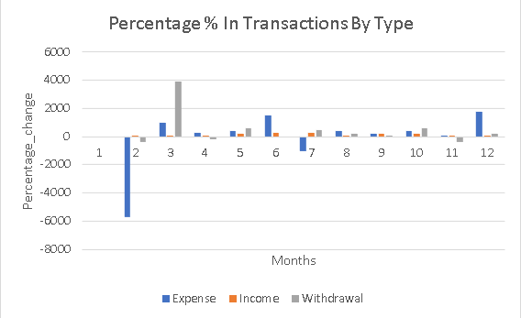
Analyzing the February Transaction Decline
In February, there is a sharp decline in total transactions, with a –42% drop in transaction counts.
To understand the reason behind this decline, a deeper analysis using other columns is required.
One major contributing factor is the significant decrease in Expense-type transactions, which show a drop of around 5,700 transactions in February.
This reduction in Expense transactions is likely a key reason behind the overall fall in transaction volume.

Slide 40
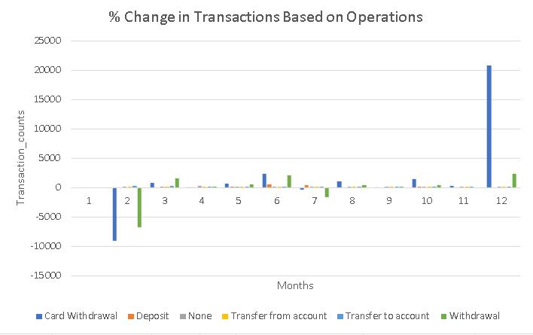
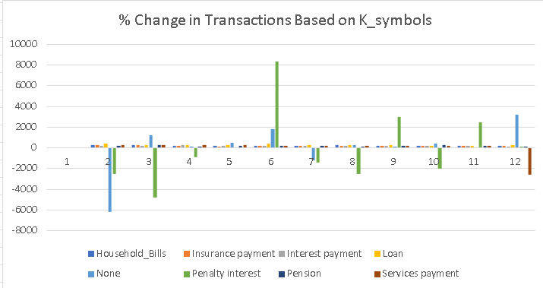
Drivers of Monthly Transaction Declines and Spikes
In above line chart we can observe that there is a decrease in Card Withdrawal as well as cash withdrawals which also a reason to drop in transactions.
In Below line chart there is a drop of expenses on the based of k_symbols which are household bills and penalty interest .
There is a sudden increase in Transactions in Month December by 11% change by previous months it can be explained from above chart it is because of operations are being consumed more .

Slide 41
Customer Behavior Analysis

Slide 42
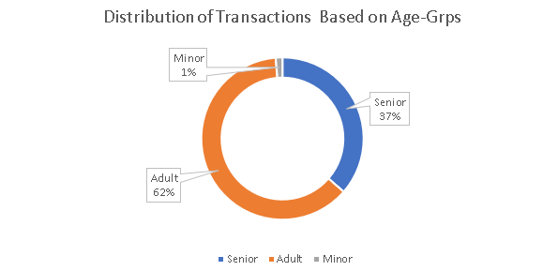
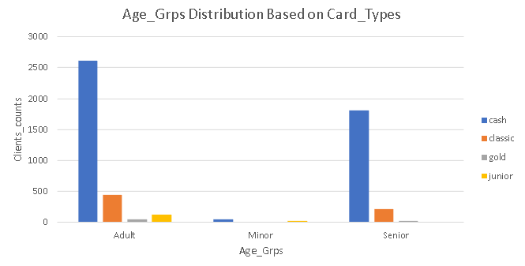
Age-Wise Transaction Trends & Cash Usage Insights
Distribution of Transactions Based on Age-Grps
Adults contributes the most in terms of Transactions about 62% and then senior about 37%
Least contributed by Minor only 1% of total
In below chart we can see how the age_grps using which card_types the most
Adults about 2 thousands of transactions done is in cash which depicts they still lagging behind in adopting digital payment methods.
Same for senior they have done about more than 1 thousands transactions in cash
After cash transactions , classic card contributes the most and the least one is the gold.

Slide 43
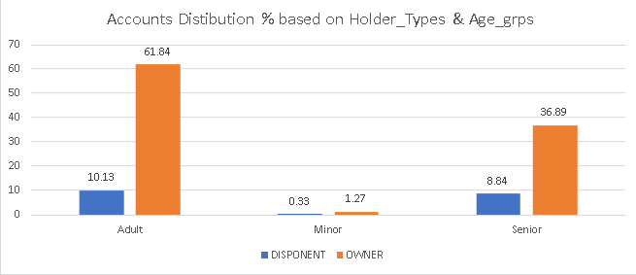
Ownership Structure by Age Group
There are Two types of account holder – despondent & owner
Owner – The account owner how have all the rights to do transactions.
Despondent -Means the client can operate the account, but does not own it
In Case of Adults 61% of account holder are owner and only 10% are despondent
In case of Minor owner are of 1.2% and 0.33% are despondent .
In case of senior the owner are 36.89% of owner and 8.84 are despondent.

Slide 44
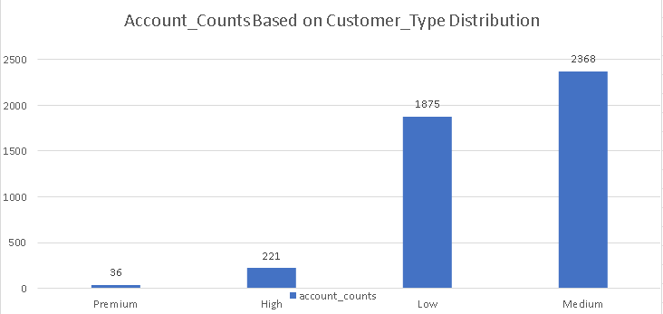
Customer Segmentation Based on Activity Scores
The Customer Type Distribution based on Accounts
The customer type classified into premium ,high ,low , medium
This customer classification is based on two factors
( Activity_Scores = Customer_Duration % + Trans_Counts%)
If activity_scores is between 12% and 15% then ‘Premium_Customer’
If activity score is between 9% and 14% then ‘High_Value_Customer’
If activity score is between 4% and 9% then ‘Medium’ and less than 4% then it is ‘Low_Value_Customer’
Customer are of Medium type contributes the most then low and at least premium value customers.

Slide 45
Loan Analysis

Slide 46
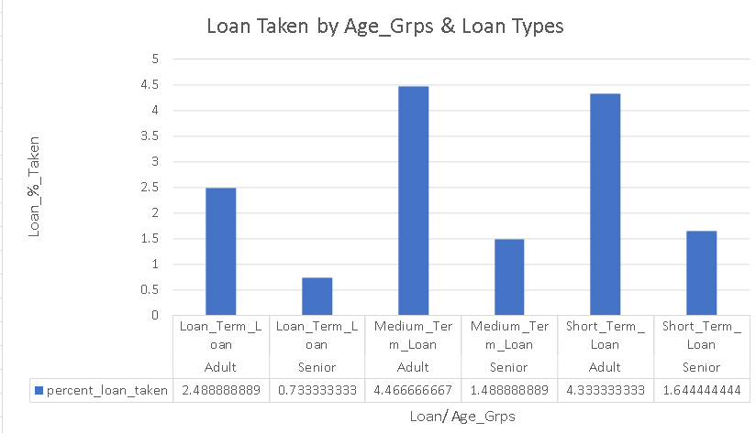
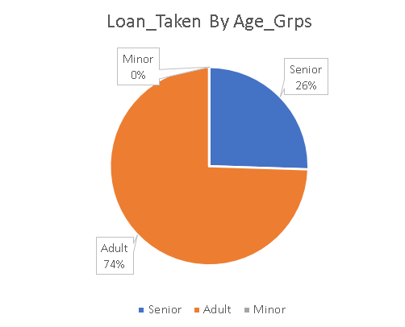
Loan Distribution Across Age Groups and Loan Types
Loan_Taken By Age grps distributed like most loan taken by Adults about 74% .
Then Senior about 26% of loan and as minor is not eligible to take loan is 0%.
The adults are more relying on the medium-term loans whose duration is between 36 and 48 months then Long-term loan taken about 2.48%.
The seniors are relying more on short term loans about 1.64% and then Medium-term loan
The loan taken by Adults are the most and they are taking Medium term loan the most and then Seniors are taking loan about 26% and they are taking short term loan the most

Slide 47
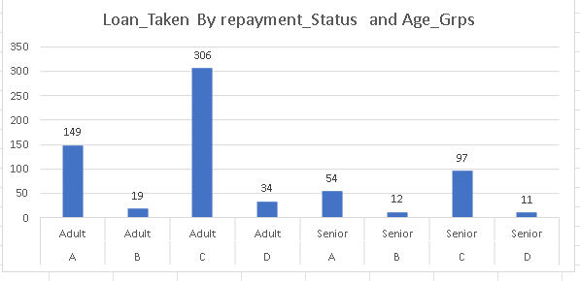
Loan Repayment Status Across Age Groups
Loan repayment status the status are being classified into A,B,C,D
In which A – ‘No Delays’ , B – ‘Mild Delays’ ,C – ‘High Delays’ , D – ‘Bad Debts’.
For both classes of senior and adult the repayment status is C which means there is a High Delays .
For repayment status both classes actually performing same as in both c status are most contributed then the A status .

Slide 48
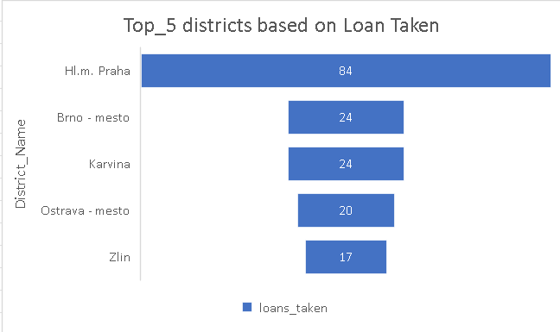
Loan Distribution by District
These are the Top 5 Districts who have given the loan most
To find out what was the reason behind the loan is given to these district are most is :
These Top 5 districts Avg population , Avg salary ,Avg Ratio of Urban Population is greater than the avg population Avg salary ,Avg Ratio of Urban Population of the whole district dataset respectively .

Slide 49
Business Problems & Recommendations

Slide 50
Business Problems
1) Mis-classified Transaction data :
In Transaction Data the transaction Type is classified into 3 – Income ,Expense ,Withdrawals
Under Expense there are transaction of withdrawals as well there is separate withdrawal type which can be misclassified the banks need to recode them to avoid these types of confusions in analyzing and reporting.
Recommendation :
Automated checks:
Flag any new transaction with missing k_symbol for review before it enters the reporting system.
2) Missing Data :
Under Income as Well expense type the k-symbols of them are none which means that banks are not keeping details of the reason of records which can leads to confusion in interpretation.
Recommendation - For accurate reporting, the bank should recode or consolidate transactions:
True withdrawals should only appear in Withdrawals.
Other spending (payments, bills) should stay under Expense.

Slide 51
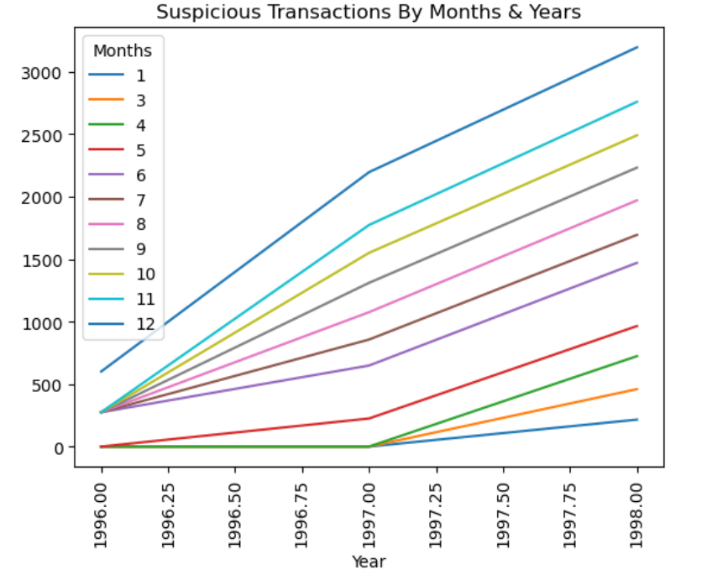
Business Problems
3) Suspicious /High Value Transactions
Transactions are considered suspicious when the transaction amount is unusually high, defined as amounts above the 99th percentile (0.99 quantile).
To identify genuine suspicious activity, additional conditions were applied:
High transaction amount
High frequency of transactions (more than 200)
Occurring within a short time period, categorized by month and year
Based on these criteria:
21 transactions were identified as suspicious/high-risk transactions
The highest number of such transactions occurred in January and November
The lowest occurrence was observed in December
Recommendation – To put high alerts if the transaction not come under above condition to control fraudulent transactions

Slide 52
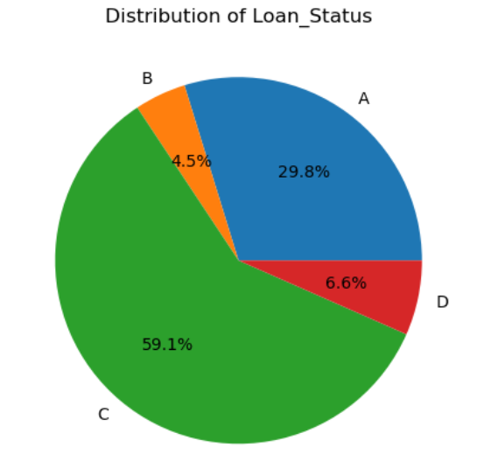
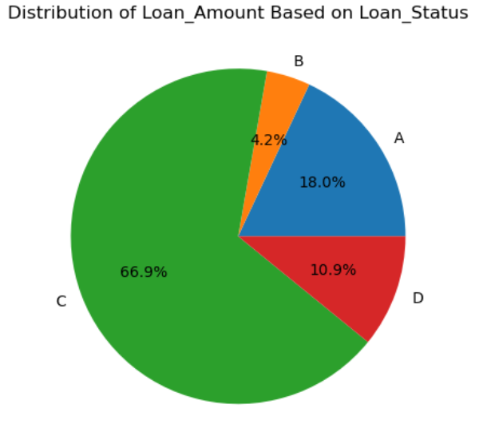
Business Problems
4) Problem in Assigning Loan to customer .
Loan repayment status shows that:
C status accounts for 59.1% of total loans
A status accounts for 29.8%
D status accounts for 6.6%
When we look at loan amount distribution:
C status contributes about 66.9% of the total loan amount
A status contributes only 18.0% of the total loan amount

Slide 53
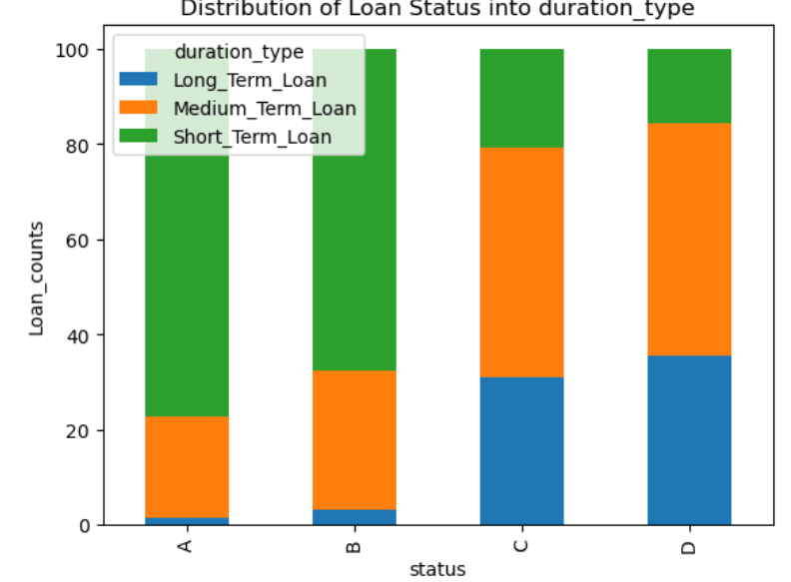
Business Problems
4) Problem in Assigning Loan to customer .
The loan assigned for short duration are coming most in A,B status in Repayments of loan which means it is easier for customer to repay the short term loan .
The loans of type Medium and Long term loans are coming most in C,D status which means repayment of there type of loan by customer is difficult .
“This indicates that the bank’s loan risk is concentrated in medium- and long-term loans, and stricter credit assessment is required for higher loan amounts and longer durations.”

Slide 54
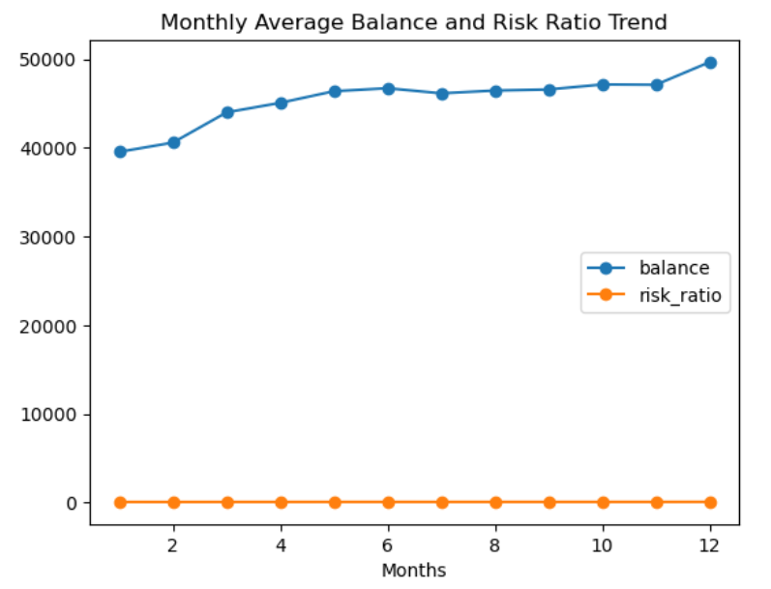
Business Problems
5) Risk Ration Trends & Dips .
Risk_Ration = account_balance / amount_loan
Risk ration is all about the money kept in balance to repay the loans is there is not .
The risk ration shows a positive trends but there is a dip in month of February which shows a short-term liquidity stress which is recovered in other months as there is increase in the risk ration after that.

Slide 55
Business Problems
6) February dip constants among all 6 years .
Every year in month of February :
Total Transaction goes down about = 42%
Expense Type Transactions go down 5,700 transactions
Risk ratio also goes down in this month
All this depicts that customer not having much money their account to repay the loan and to continue their expenses .
Banks can adjust their threshold for month of February as this a seasonal pattern but not a big risk problem as there is a gradual increase after this month

Slide 56
Wrap-up
This banking dataset contains 8 tables, all of which were analyzed in-depth to understand customer behavior, transaction patterns, and loan trends.
A total of 10,56,320 transactions were recorded.
Expense-type transactions contribute the highest share, followed by Income, with Withdrawals being the lowest.
1993 shows the lowest transaction count, while 1998 shows the highest.
The data spans 6 years, and there is a clear upward trend in transaction counts from 1993 to 1998.
Time-Based Insights
Saturday has the highest number of transactions.
Wednesday has the least number of transactions.
December is the peak month, whereas February shows a significant drop.

Slide 57
Wrap-up
Income Type Insights
Within Income transactions, most of them are cash-based, recorded as “none”, indicating customers frequently handle cash that isn’t digitally tracked.
The next most common income type is transfer to accounts, while card withdrawals are the lowest.
This reflects that customers still rely heavily on cash transactions.
Loan Insights
Adults are the most active loan takers, while minors (0%) are not eligible for loans.
Adults and seniors both prefer short-term loans.

Slide 58
Wrap-up
Overall, clients take short-term and medium-term loans far more often than long-term loans.
District Insights
The top 5 districts contribute the highest number of transactions.
These districts also have higher average population, higher average salary, and a higher ratio of urban population compared to the entire district dataset.
This indicates that districts with larger and more urbanized populations show higher banking activity

